Slide 1

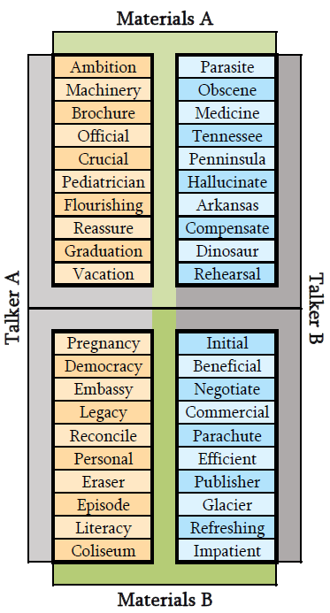
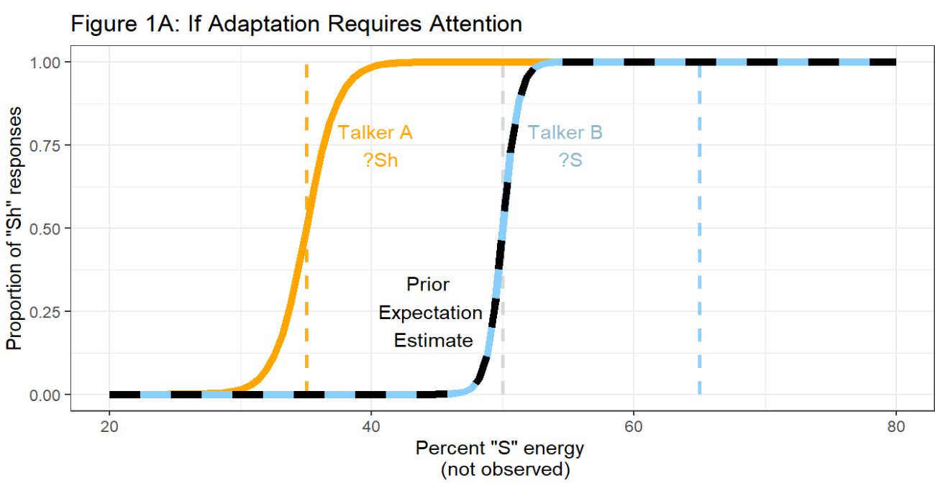
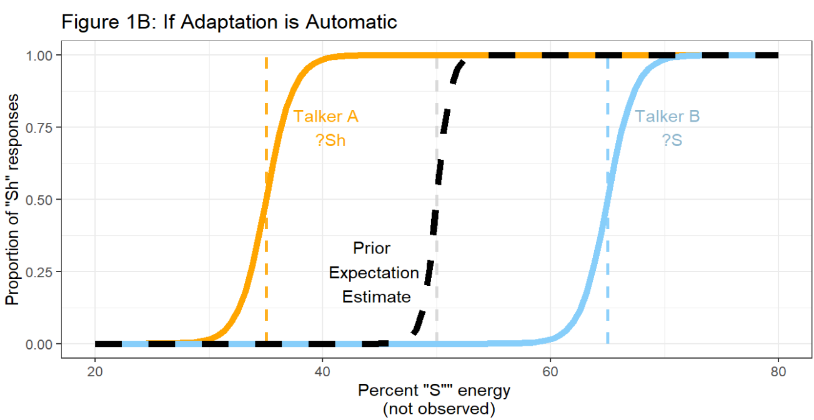
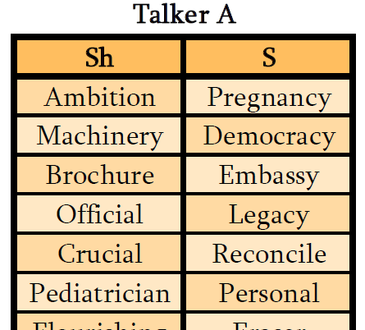
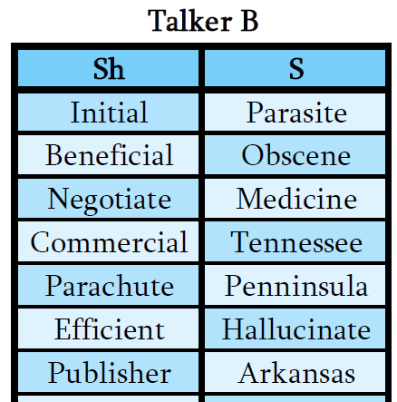
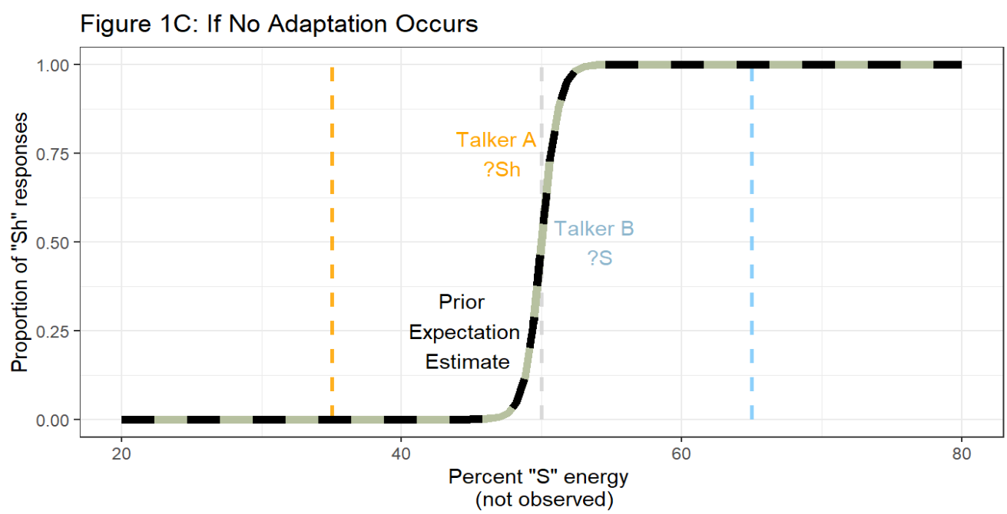



Background
Exploring the Automaticity of Speech Perception and Adaptation
Despite spoken language being highly variable, listeners can often understand newly encountered talkers when hearing them speak for the very first time. Variation in speech presents a unique challenge for cognitive processing that is solved seemingly automatically: Our brains learn how talkers speak, and then apply this information to construct expectations about speech they encounter in the future. This process often occurs without the listener even noticing. However, this phenomenon presents the question of how automatic is speech perception adaptation? Are we constantly processing any speech we happen to hear in our environment? In this study, we will explore the automaticity of speech perception and adaptation when participants’ available attentional resources are limited. To achieve this, we will expose listeners to two talkers speaking simultaneously, and test the effects of directing the listener’s attention to one talker on the listener’s ability to adapt to both talkers.
Rachel Sabatello¹, Shawn Cummings², & Florian Jaeger¹
¹University of Rochester, Department of Brain and Cognitive Sciences
²University of Connecticut, Department of Speech, Language, and Hearing Sciences
Design
In this study, we will be measuring listeners’ perceptual adaptation to two simulated talkers’ S-ʃ production.
S-Sh sounds exist on a continuum, spanning from “s” as in “Sock” to “sh” as in “Shock.” Earlier research suggests that listeners’ adaptation to S-Sh production is talker-specific, meaning that listeners adjust their perceived boundary between S-Sh for each talker (Kraljic & Samuel, 2005). In contrast, listener’s judgement of other sound categories can be influenced by and applied to multiple talkers. This quality of how the S-ʃ is perceived could allow us to simulate two distinct talkers with different S-ʃ productions during the same experimental exposure (Cummings & Theodore, accepted).
Hypothesis
Critical Trials
Exposure Phase
We hypothesize that speech perception adaptation is contingent upon attention. If there are limits to the automaticity of speech perception, then we expect listeners will adapt their perceived categorical boundary to align better with the speech of the talker they are attending to compared to the unattended talker.
Talker A and B recordings were paired to create Materials A and B. Half of the participants will hear the words in Materials A with the simulated accent (?S, ?Sh), and the words in Materials B without the accent (S, Sh). The other half of the participants will hear the inverse.
Our critical stimuli are created from 40 recordings of S/Sh words, each spoken typically (S, Sh) and accented (?S, ?Sh) (Kraljic & Samuel, 2005).
All recordings were processed using Praat (Boersma, 2002) to simulate the words being spoken by a male talker and a female talker (Luthra et al., 2021).
The horizontal word pairings in Materials A & B were then spliced together to create stereo audio files where one talker is played in the left ear, and the other in the right ear. Ear assignment will be counterbalanced across participants.
Predictions
Predicted results if adaptation is not automatic:
Adaptation is found only for the attended talker.
Gender will be counterbalanced such that each experiment will have a male and a female talker:
Filler Trials
Each experiment consists of 80 total exposure trials, including 20 critical trials and 60 filler trials. During filler trials, one talker will say a word and the other talker will say a nonword. The attended talker will have a 50% chance of saying a nonword.
These words were split in half to create two sets of words representing two talkers: 10 unique S words and 10 unique Sh words were allocated to each talker.
Paradigm
Predicted results if adaptation is automatic:
Adaptation is found for both talkers
Participants will be instructed to attend to either the female talker or the male talker. They will then perform a series of 2-option forced-choice lexical decision tasks, in which they will hear a recording and then select if the attended talker said a word or a nonword (see below).
Listen
Select
Predicted results if there is no adaptation to either talker:
Simultaneous exposure to two talkers could disrupt the necessary attention to adapt to either talker
Figure 4: A static representation of how a participant will progress through a trial. Each trial will begin with the participant hearing an audio file, and then selecting either “Word” or “Nonword”.
Figure 3: A visual illustrating how the words spoken by Talker A and Talker B will be paired to produce two sets of materials.
Figure 2: The lists of s and ʃ words that will be produced in Talker A’s voice (left) and Talker B’s voice (right).
Test Phase
ashi
asi
After the Exposure Phase, participants will hear the asi-ashi test continuum in each talker’s voice. This continuum is used to gauge when listener’s shift from perceiving a sound as “Sh” to “S” (see right). Each trial will only play a recording from a single voice at once. Participants will select if the audio they heard was “asi” or “ashi” for each trial to produce results like the predictions, shown to the left.
Figures 1A, 1B, & 1C: Graphical representations of listeners responses to the asi-ashi test continuum during the Test Phase. As the percent of /s/ energy in the stimulus increases, the more likely participants are to respond “ashi” (/ʃ/), rather than “asi” (/s/). If perceptual adaptation is dependent on attentional resources, we anticipate listener’ adjustment to the unattended talker will be constrained (Figure 1A).
Sh
?s/?sh
S
Figure 5: “S” and “Sh” sounds exist on a spectrum, where “asi” can be altered to sound like “ashi” by changing the percentage of “S” energy.
References
Acknowledgements
Implications
Boersma, P. (2002). Praat, a system for doing phonetics by computer. Glot International, 5(9/10), 341–345.
Cummings, S. N. & Theodore, R. M. (accepted). Perceptual learning of multiple talkers: Detriments, characteristics, and limitations. Attention, Perception, & Psychophysics.
Kraljic, T., & Samuel, A. G. (2005). Perceptual learning for speech: Is there a return to normal?. Cognitive psychology, 51(2), 141-178.
Luthra, S., Mechtenberg, H., & Myers, E. B. (2021). Perceptual learning of multiple talkers requires additional exposure. Attention, Perception, & Psychophysics, 83, 2217–2228.
Tzeng, C. Y., Nygaard, L. C., & Theodore, R. M. (2021). A second chance for a first impression: Sensitivity to cumulative input statistics for lexically guided perceptual learning. Psychonomic Bulletin & Review, 28, 1003–1014.
Thank you to Dr. Tanya Kraljic and Dr. Arthur Samuel for their permission to use the stimuli they developed (Kraljic & Samuel, 2005), the 2022 Meliora Mentors, the HLP Lab and the University of Rochester Brain & Cognitive sciences department.
A listener’s perceptual boundary changing more to fit the attended talker’s speech than the unattended talker’s speech would suggest there are limits to the automaticity of speech perception. Conversely, complete adaptation to both talkers would suggest that humans automatically adapt their perception to any speech in their environment.
This project was funded by the University of Rochester Wiesman summer fellowship in brain and cognitive sciences.

